Slide 1
Ahlstrom-Munksjö
Filtration & Performance BA
DEC 2018

Slide 2
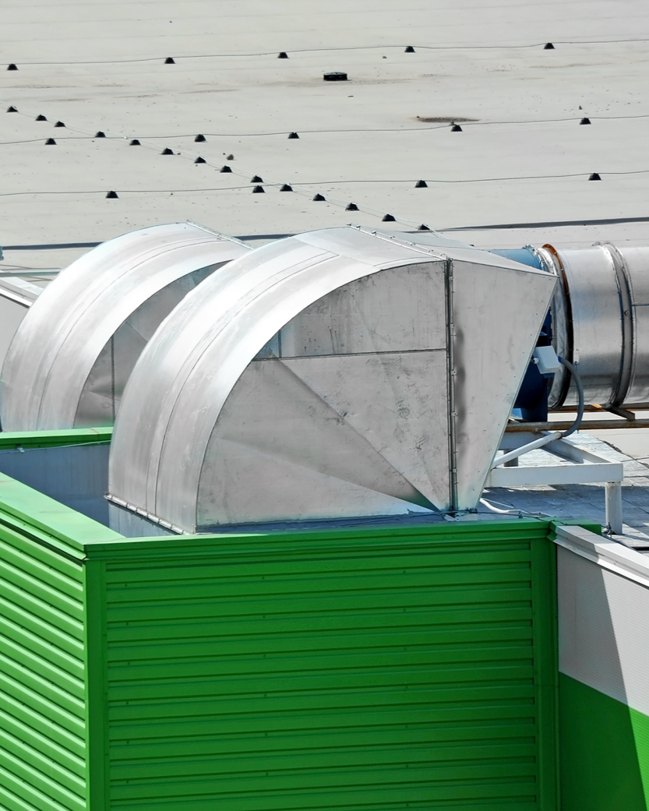
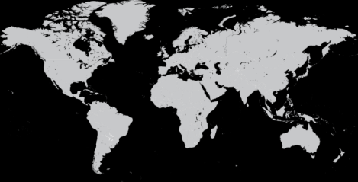
Business area
Filtration & Performance
Mikkeli - Finland
Karhula - Finland
Tampere - Finland
Ställdalen - Sweden
Tver - Russia
Taylorville - US
Malmedy - Belgium
Binzhou - China
Madisonville - US
Hyun Poong – Korea
Brignoud - France
Turin - Italy
Fabriano - Italy
Louveira - Brazil
Exposure
to customer
sectors
Automotive
Energy
Construction
General industry
Non-food
consumer goods
Health care &
life science

Slide 3

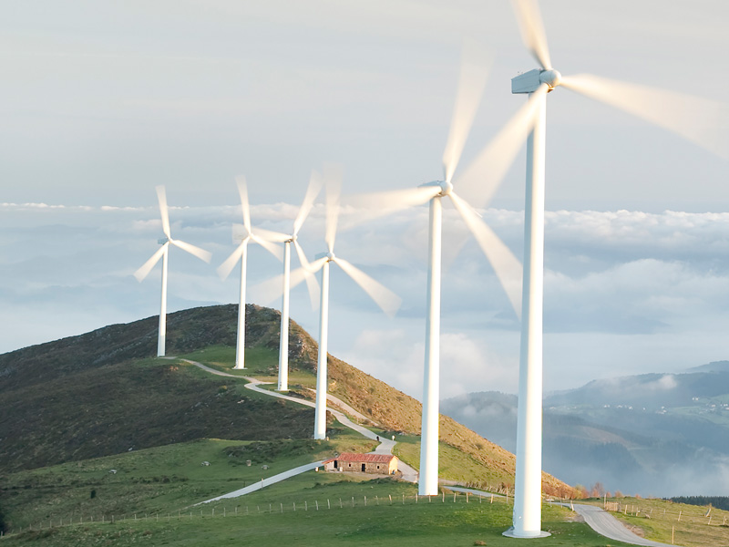

Filtration and Performance: Business Units
Filtration ~425 MEUR
Building & wind ~ 100 MEUR
Nonwovens ~130 MEUR

Slide 4
Business Portfolio Filtration and Performance
Filtration
Building and Wind
Nonwovens
Transportation filtration: heavy duty and automotive tier 1 suppliers
Industrial filtration: gas turbine filter producers; indoor air quality filter makers
Cushion vinyl flooring producers
Wind turbine manufacturers
Hygiene and wound care producers
Laundry care suppliers
Automotive and construction material suppliers
Wallcover printers
Flushable wipes producers
CUSTOMER industries
Increasing car and truck fleet globally
More stringent emission regulation
New filtration applications in electrical mobility
Increasing importance of air quality
Growing energy demand (gas turbine)
Growing demand in luxury vinyl tile (Flooring)
Growing demand for renewable energy (Wind blades)
Growing demand in wallcover in China
Tighter guidelines and labelling systems driving shift towards truly flushable products
Dry construction method driving increasing demand for wet resistant plasterboard
DEMAND DRIVERS and market trends
MARKET growth*
CAGR: 3–5%
CAGR: 3–5%
CAGR: 3–5%
Neenah
Hollingsworth & Vose
Lydall
Owens Corning
Johns Manville
NeuKallis
Glatfelter
Aralar
Qifeng
MAIN COMPETITORS
*Management estimates

Slide 5
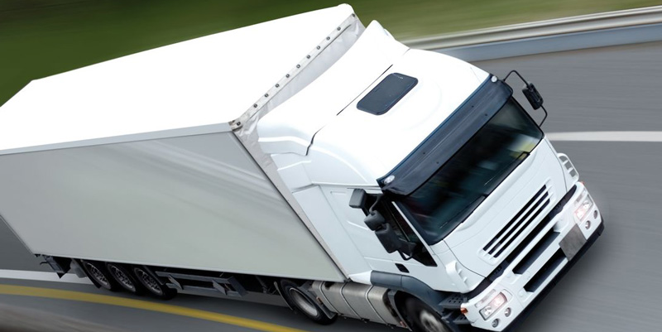
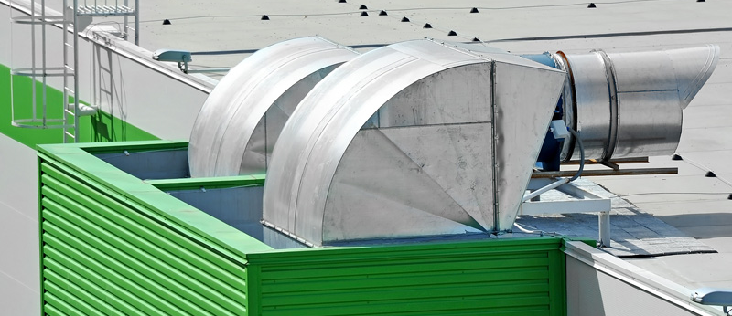
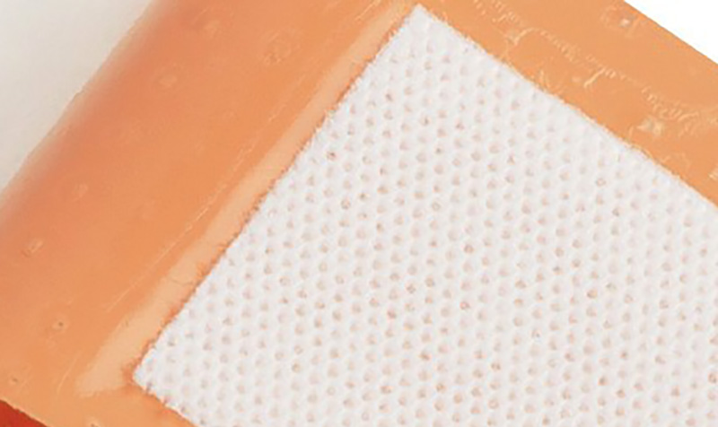
Products in Business area Filtration & Performance
Product area | Applications | Customers
Engine filters | Oil filtration Fuel filtration Air filtration | Heavy duty and automotive tier 1 suppliers
Industrial filters | Gas turbine filtration Industrial filtration | Gas turbine filter producers Indoor air quality filter makers
Wallcovers | Decorative wallcovers Wall-liners | Wallcover industry Digital printing companies
Building & Wind Glass fiber tissue | Cushion vinyl flooring Wind turbines Boat building Pipe renovation Commercial vehicle panels | Construction and building materials producers Cushion vinyl flooring producers Wind turbine manufacturers Commercial vehicle panel manufacturers
Specialty non-wovens | Plasterboard and furniture surfaces Laundry care Hygiene and wound care Automotive Interiors Wipes | Hygiene and wound care producers Laundry care suppliers Construction materials Automotive suppliers

Slide 6

Filtration Global Manufacturing Platforms
Tampere - Finland
Turin - Italy
Binzhou - China
Taylorville, IL - USA
Fabriano - Italy
Hyun Poong – S. Korea
Madisonville, KY - USA
Key Businesses
Engine Filtration
Industrial Filtration
Manufacturing sites
Louveira - Brazil

Slide 7
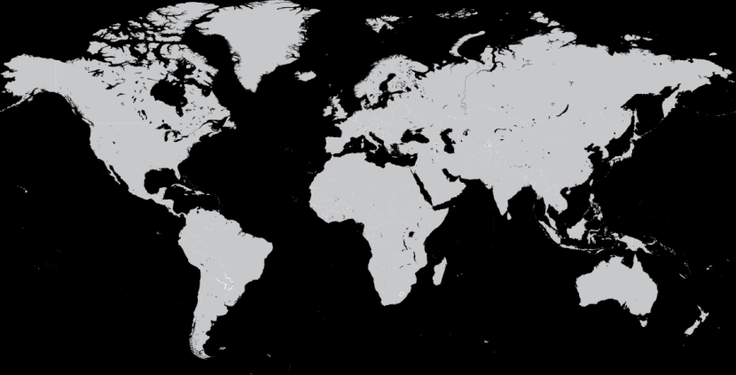
Nonwovens Global Manufacturing Platforms
Ställdalen - Sweden
Malmedy - Belgium
Brignoud - France
Key Businesses
Speciality Materials
Flushable Wipes EMEA
Wallcover EMEA & NA
Manufacturing sites

Slide 8
Building & Wind Global Manufacturing Platforms
Mikkeli - Finland
Karhula - Finland
Tver - Russia
Key Businesses
Flooring
Wind Energy
Niche applications
Manufacturing sites

